Slide 1
2012

Slide 2
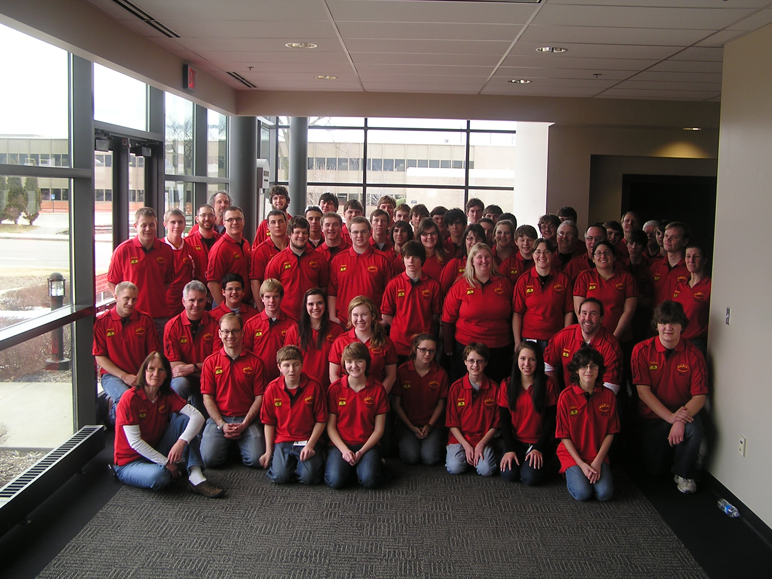

Slide 3
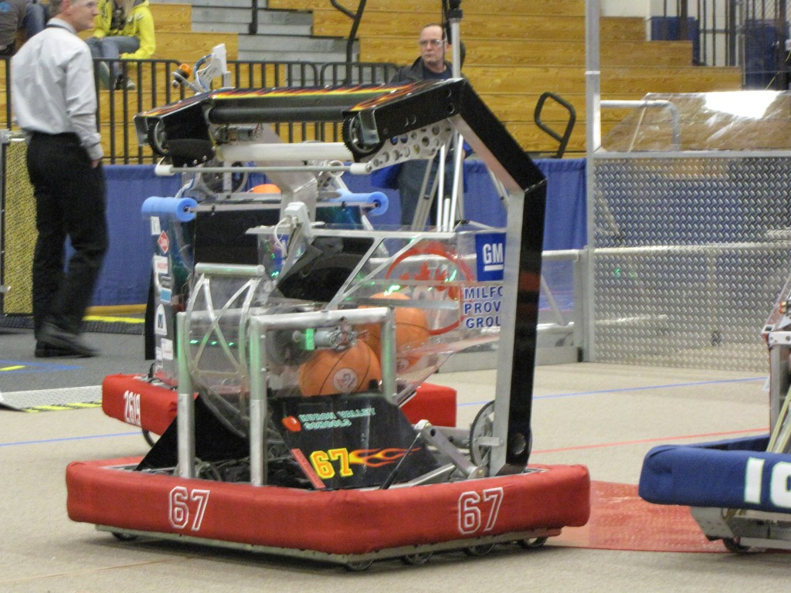
2012 Robot

Slide 4
HOT Team Sub-Groups

Slide 5
CAD (Design)
Students work with mentors using AutoDesk Inventor and Mechanical Desktop to produce 3D and 2D design for the HOTBOT, the HOT cart and CASEY.

Slide 6
Mechanical Build
Students work with mentors in the GMPG machine shop. Components for the HOTBOT, the HOT cart, practice playing field and CASEY are produced on the lathe, vertical mill, CNC and waterjet.

Slide 7
Electrical
Students work with mentors to wire and create control systems for the HOTBOT. Students experience everything from DC circuits to feedback control with potentiometers, encoders, digital cameras, accelerometers, gyroscopes. FIRST now uses an industry standard cRIO controls platform.

Slide 8
Programming
Students work with mentors to program the control system behavior of the HOTBOT and CASEY. Coding is done in C++ and/or LabVIEW. The HOTBOT must have instructions for both operator-controlled and autonomous behavior.

Slide 9
Animation
Students work with mentors to create a 30 second animation using Auto Desk Maya. This is the same type of interface as the one used by Pixar.

Slide 10
Chairman’s
Students work with mentors to document, market, and create the imagery of the HOT team. After winning the Chairman’s Award in 2005, the HOT team will always have a presence in the FIRST Hall of Fame.

Slide 11
Drive Team
The drive team manipulates the robot and plays the game during competition. The drive team usually consists of 2 drivers and a human player. This team is chosen for their skills, ability to listen to the drive team coach, ability to execute the team’s strategy, and demonstration of gracious professionalism under pressure. They are required to meet daily after the build season.

Slide 12
Scouting
This team is responsible for determining the best strategy for winning the competition and communicating it to the drive team coach. All team members who are not part of the drive team and pit crew are responsible for scouting. They scout other teams to gain information about the robots abilities and success rates. They organize this information so that it is easily accessible and ready for use during the competition.

Slide 13
Community Service

Slide 14
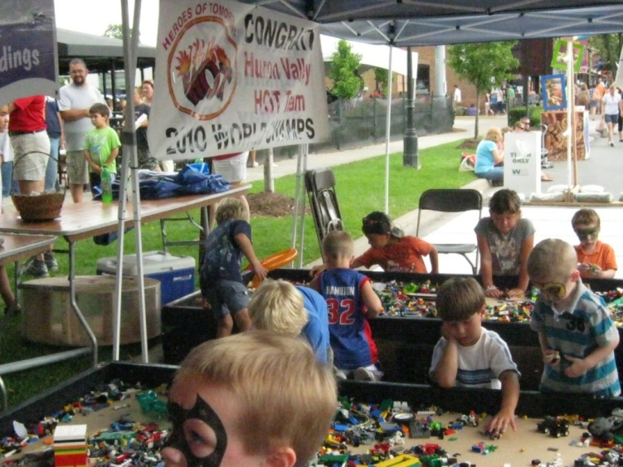
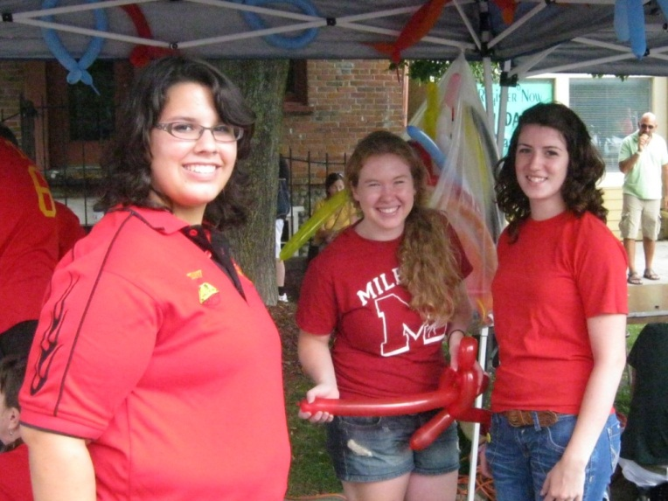
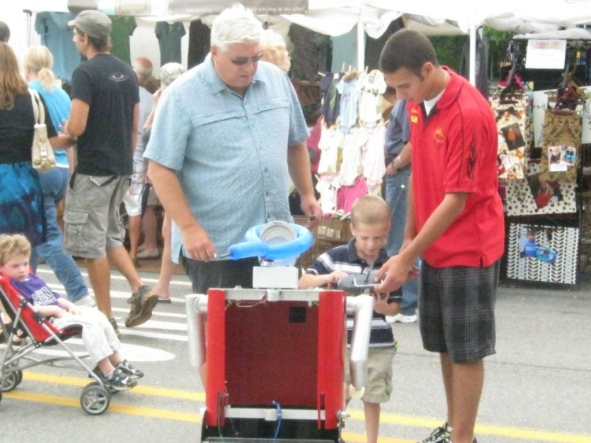
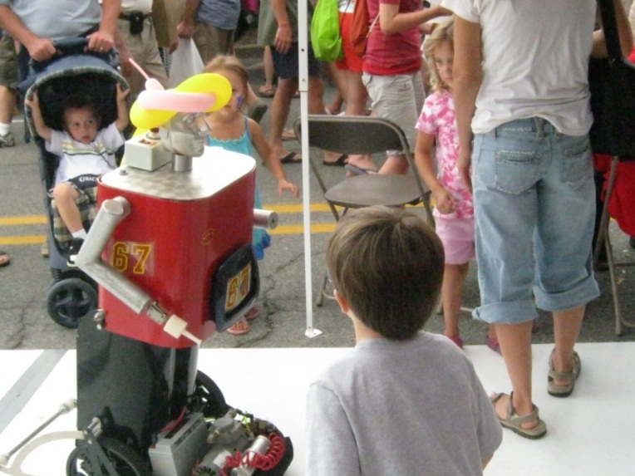
Milford Memories
The HOT Team helps out every year with an art festival in down town Milford, MI, spreading the word about FIRST and our team. Kids come from all around to build with Legos and drive CASEY, our community service robot.

Slide 15
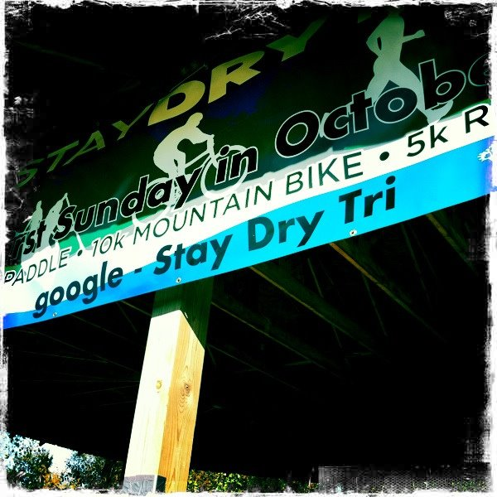
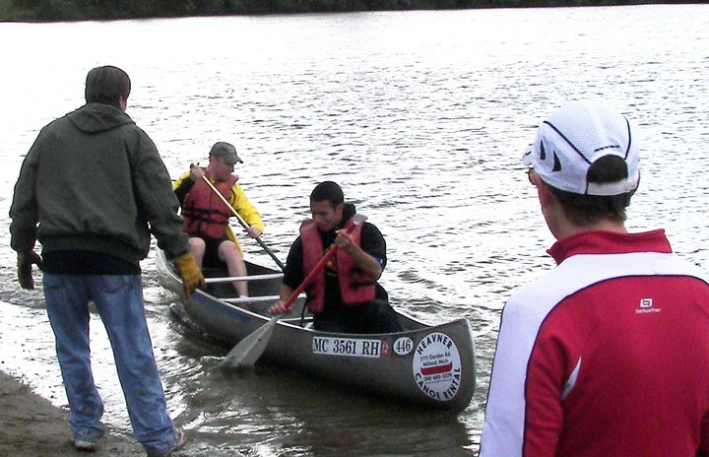
Stay Dry Tri
The Stay Dry Try is a triathlon held by the HOT Team to raise money and awareness for our team. Many of the students, mentors, and parents participate in the race in early November. This year, Alex Garrigo (a 4-year member of the HOT Team) won the race.

Slide 16
2012 Drive Team

Slide 17
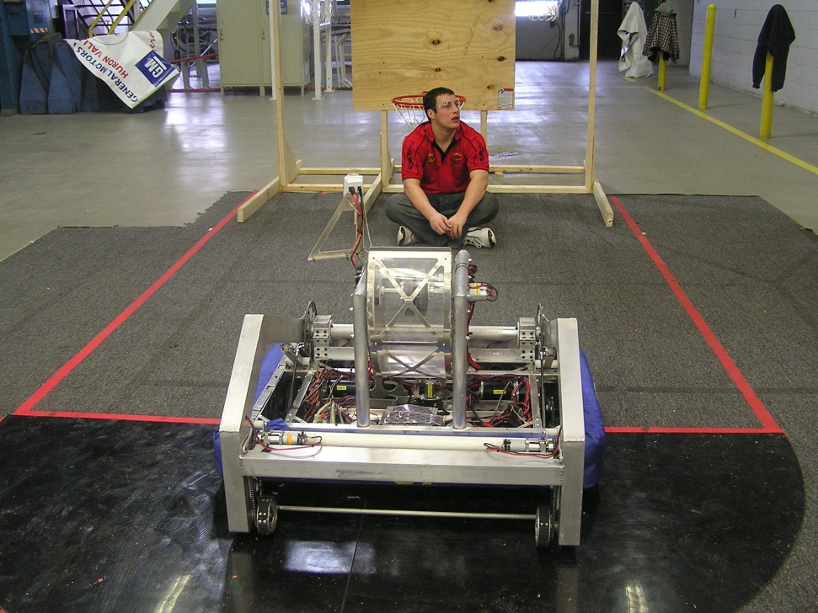
Josh Orlando
Senior at Lakeland High School
4 year HOT Team Member
2 year Drive Team Member

Slide 18
Alex Garrigo
Senior at IA West
4 years as the human player
2012 Dean’s List nominee

Slide 19
Jason Drouillard
Junior at Lakeland High School
3 year member
Helped design and build the 2011 mini-bot
This is his first year on the drive team

Slide 20
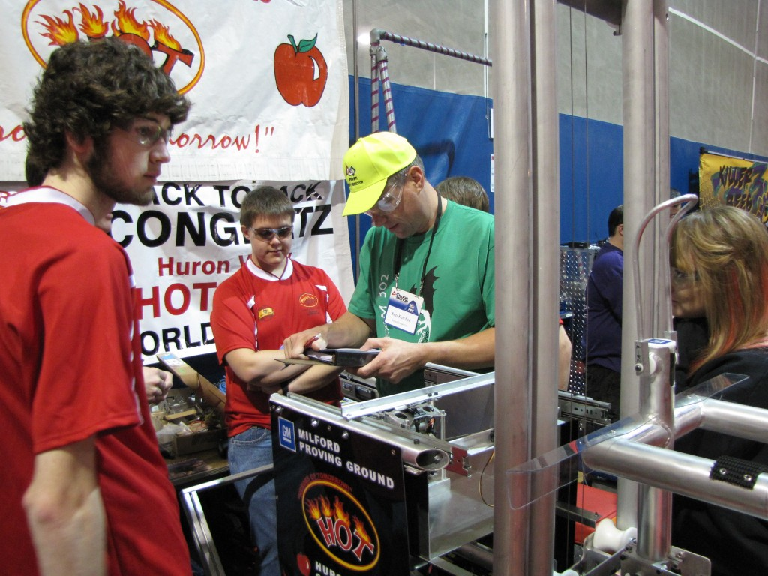
2012 Pit Crew
Lukas Senczyszyn (Sophomore)
Abbey Senczyszyn (Senior)
Casey Grebe (Senior)
Joe Elliott (Junior)
Luke Jeries (Senior)

Slide 21
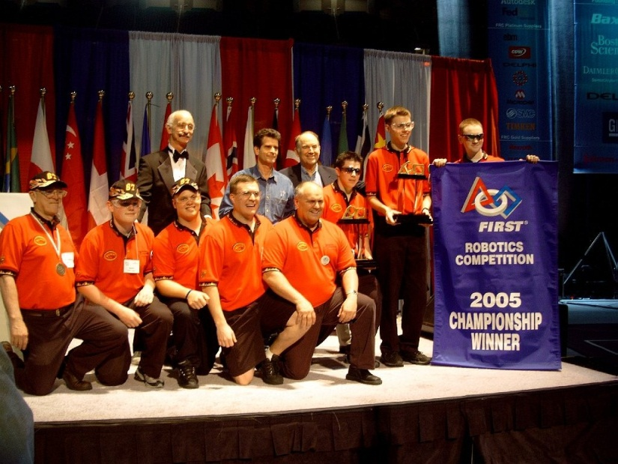
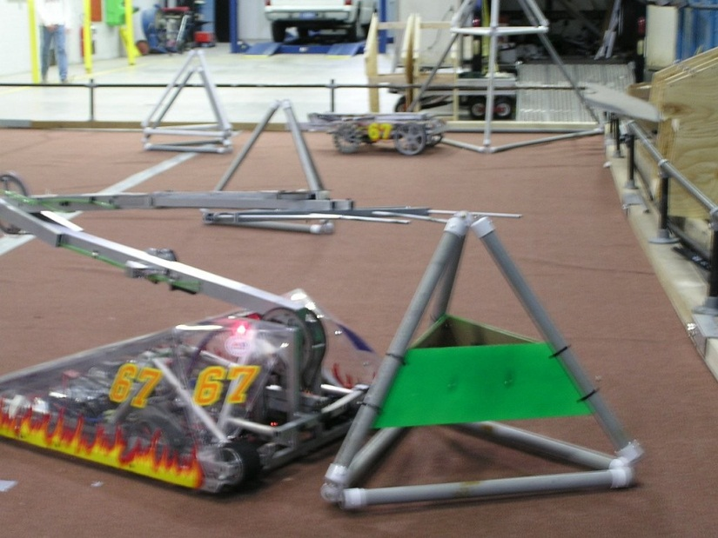
2005
In 2005, the Heroes of Tomorrow won both the Chairman’s award and the World Championship (he only team in FIRST history to earn these awards in the same year). Our theme was “The Recipe for Success,” and the presentation accomplished just that. We also won the championship in 2009 and 2010.

Slide 22
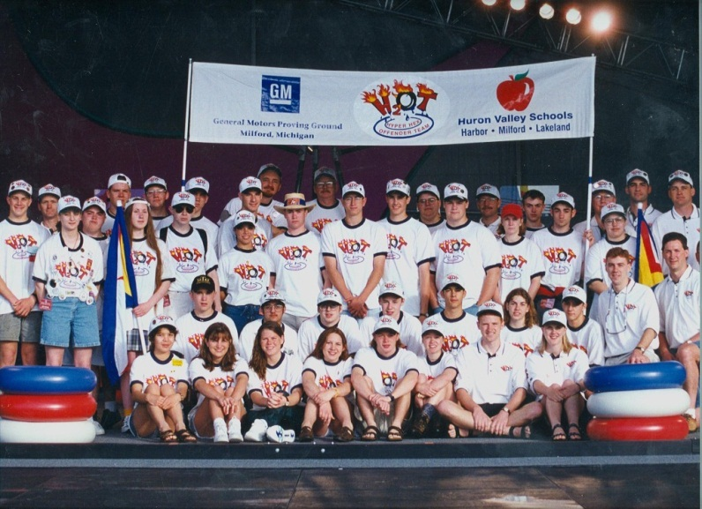
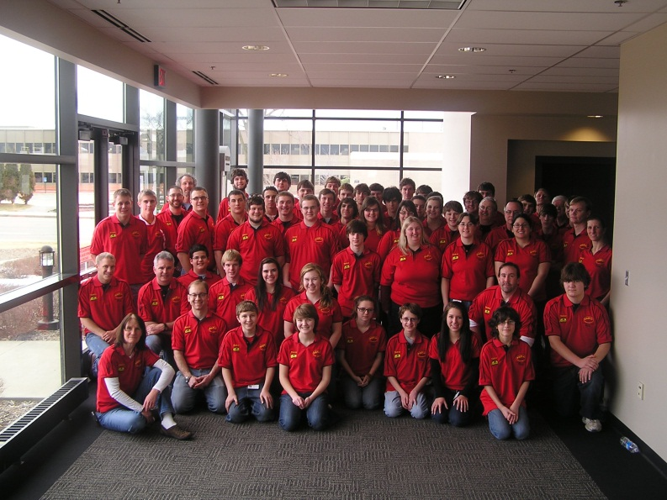
A HOT History
1997-
Rookie of the year
2002-
Dave Verbrugee wins Woodie Flower’s award
2005-
Chairman’s award and World Championship winners
2009-
World Championship winners
2010-
World Championship winners
2011-
Jim Myer wins GM mentor of the year

Slide 23
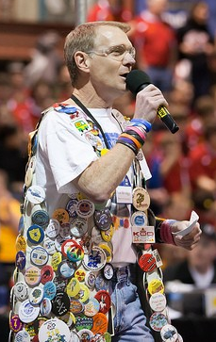
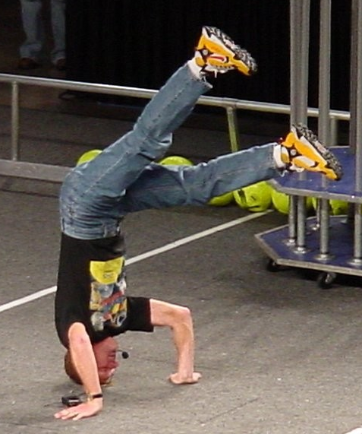
Dave Verbrugge
In 2002, Dave Verbrugge won the Woodie Flower’s award. He is often the world-famous emcee of the World Championship finals on Einstein and also one of our lead programming mentors. He is a huge supporter of FIRST, has been to Dean Kamen’s house, and does a signature hand-stand for the last match of any competition.

Slide 24
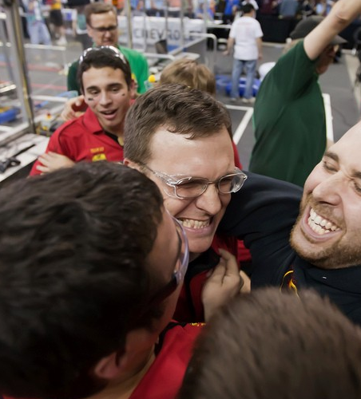
Jim Myer
In 2011, Jim Myer won the GM Mentor of the Year award. He is the lead design engieer on our team, and has been since he joined the team in 2001. He has led the design of 3 Championship robots and helped the drive teams as well. We could not do what we do without him!

Slide 25
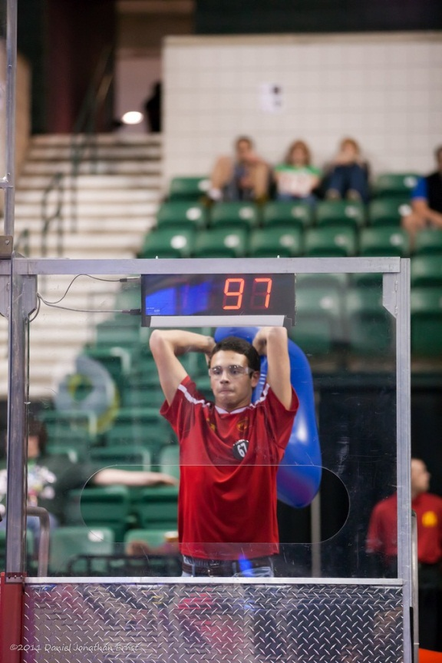
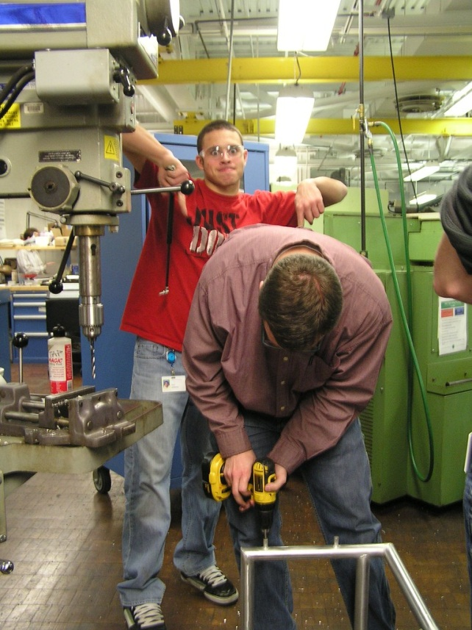
Alex Garrigo 2012 Dean’s List Nominee

Slide 26
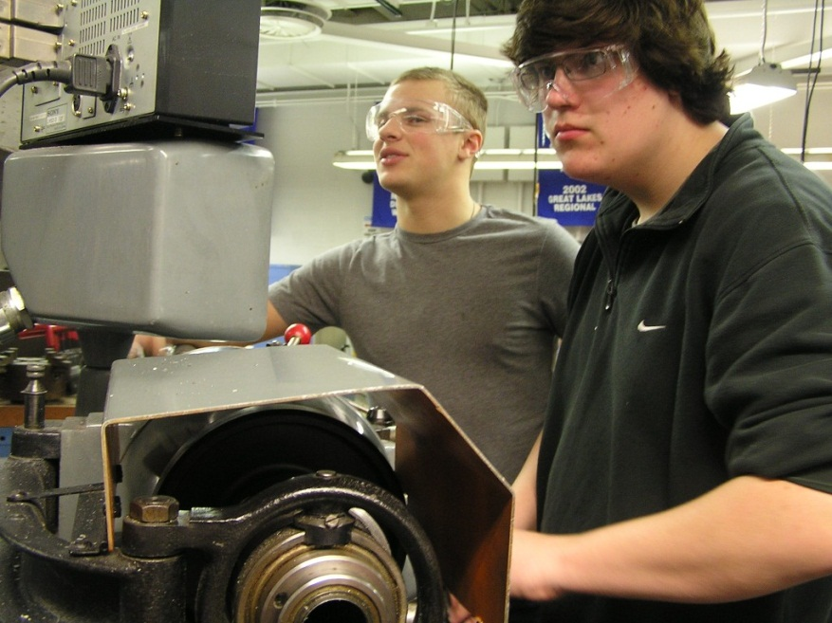
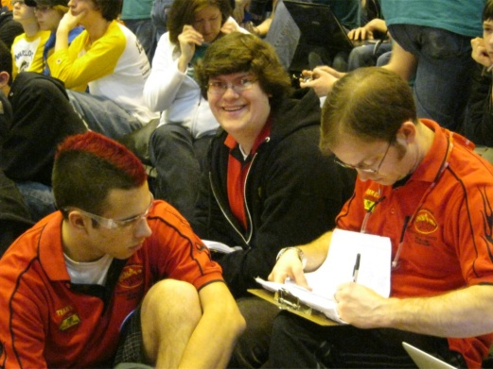
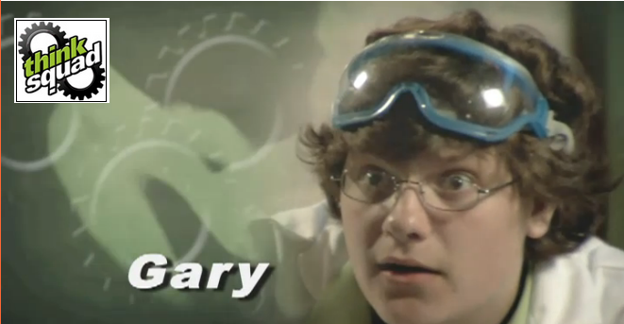
Gary Zahn 2012 Dean’s List Nominee

Slide 27
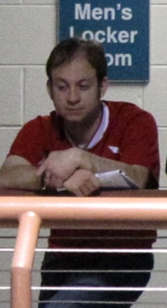
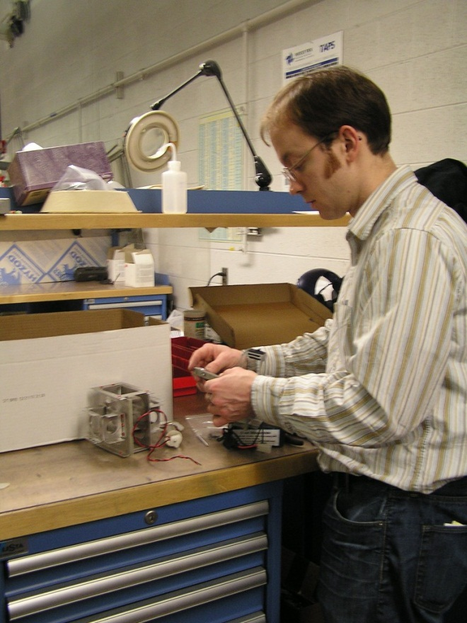
Jason Bretzlaff 2012 GM Mentor of the Year Nominee

Slide 28
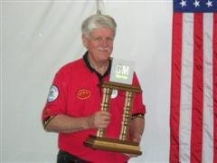
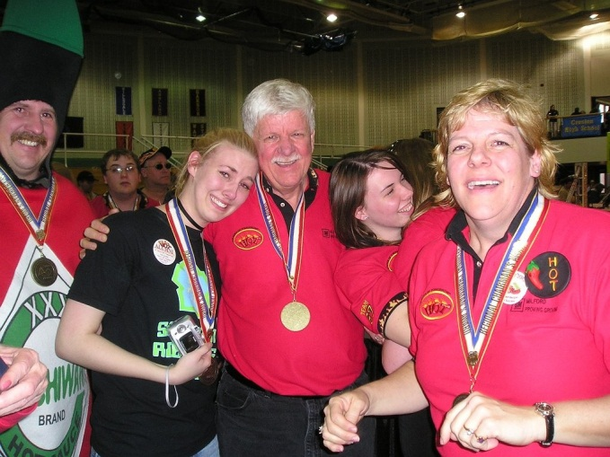
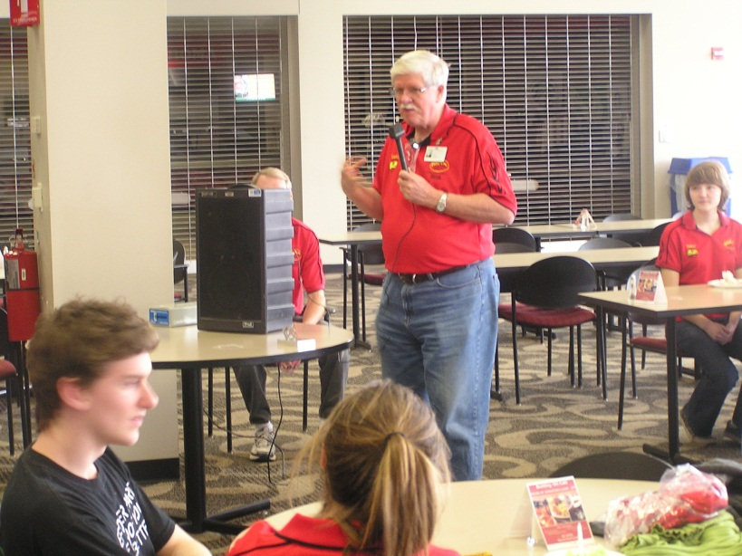
Walt Hickok 2012 Woodie Flowers Nominee

