Slide 1
Bumpers 101
FIRST Team 67
The HOT Team

Slide 2
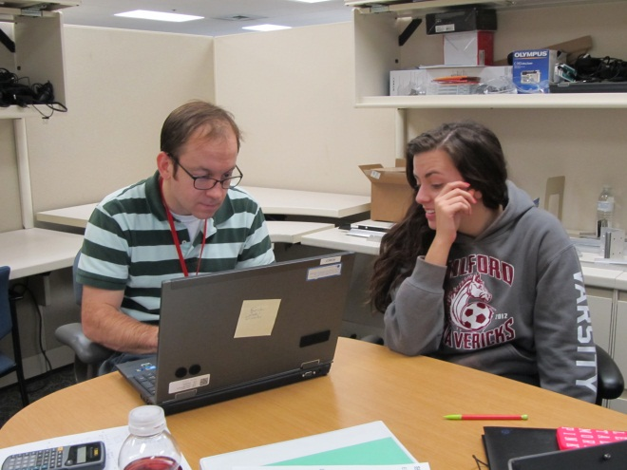
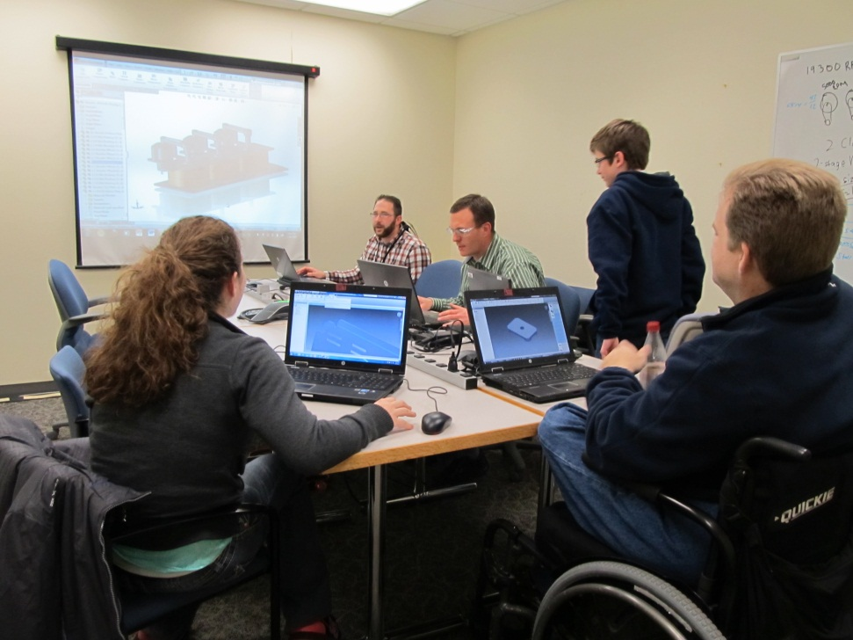
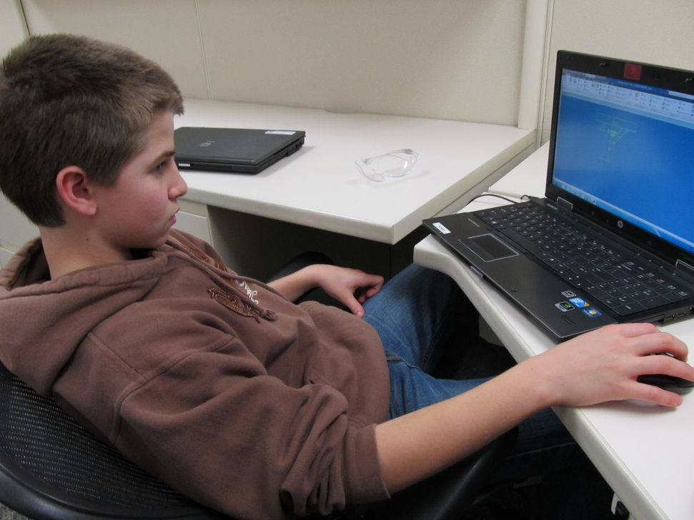
Design
Step One: Design your robot
Finalize Dimensions
Watch out for holes in frame that need to remain uncovered

Slide 3
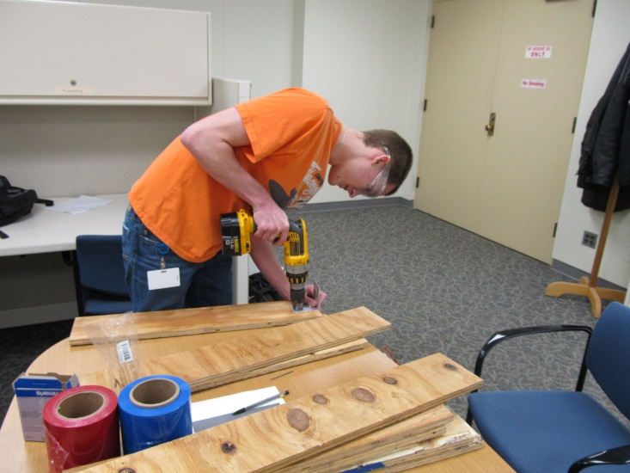
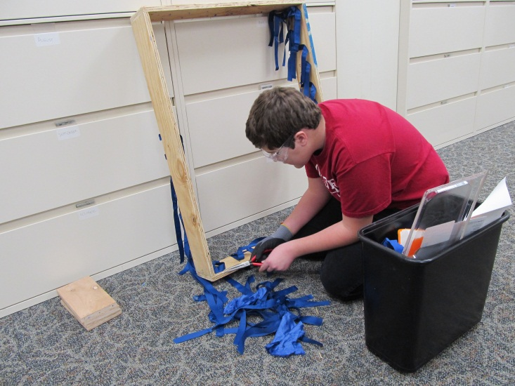
Cut the Wood
Using outside dimensions for your robot’s frame, cut your wood of choice.
Plywood is a good option, plenty strong enough for this
Pieces should form a layer outside your robot’s frame
This year we recycled the wood from previous year’s bumpers to make a rookie team’s

Slide 4
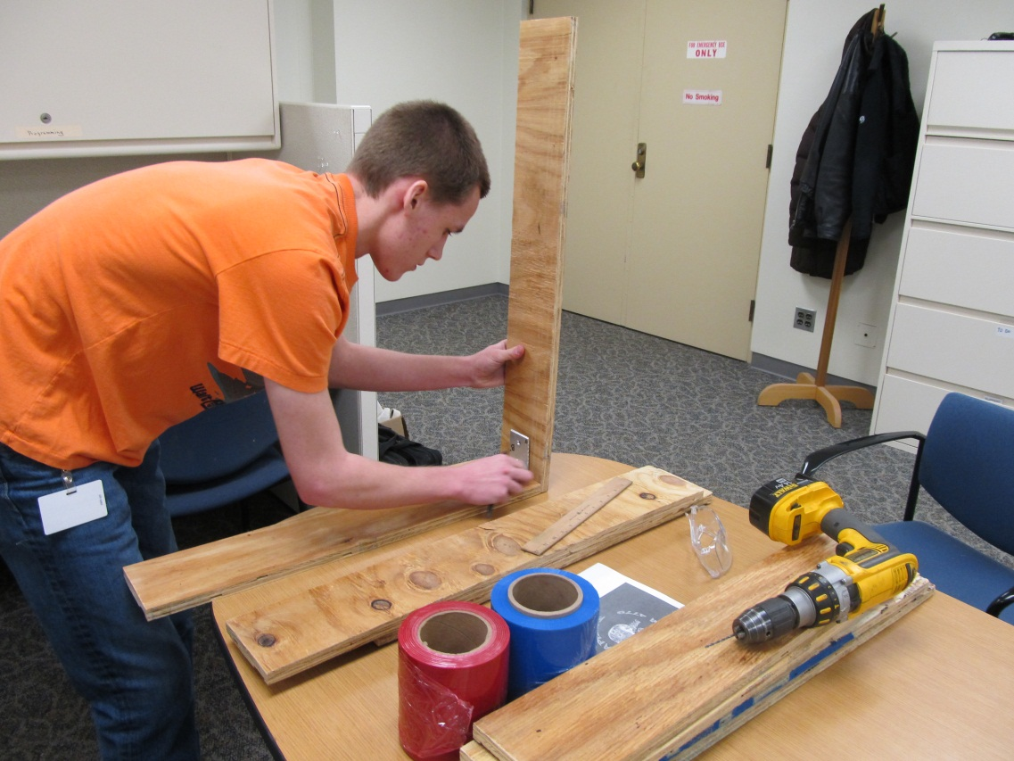
Drill, Secure and Reinforce Bumpers
Drill holes for wood screws to form simple butt joints.

Slide 5
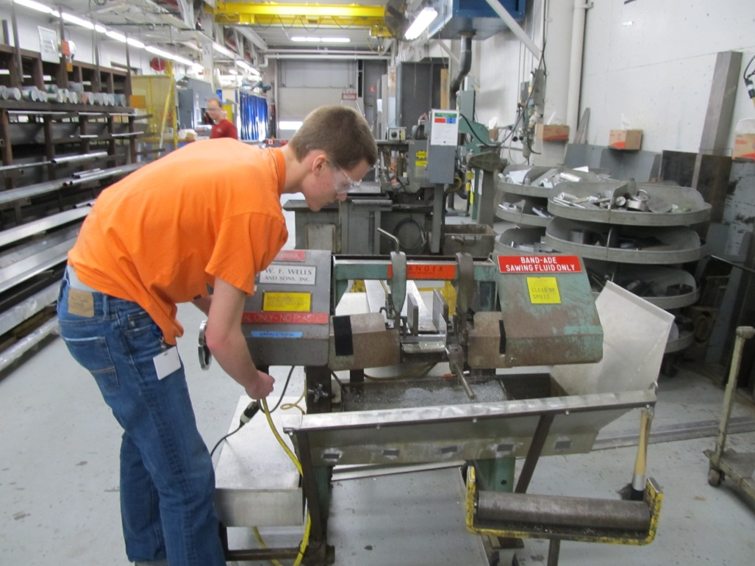
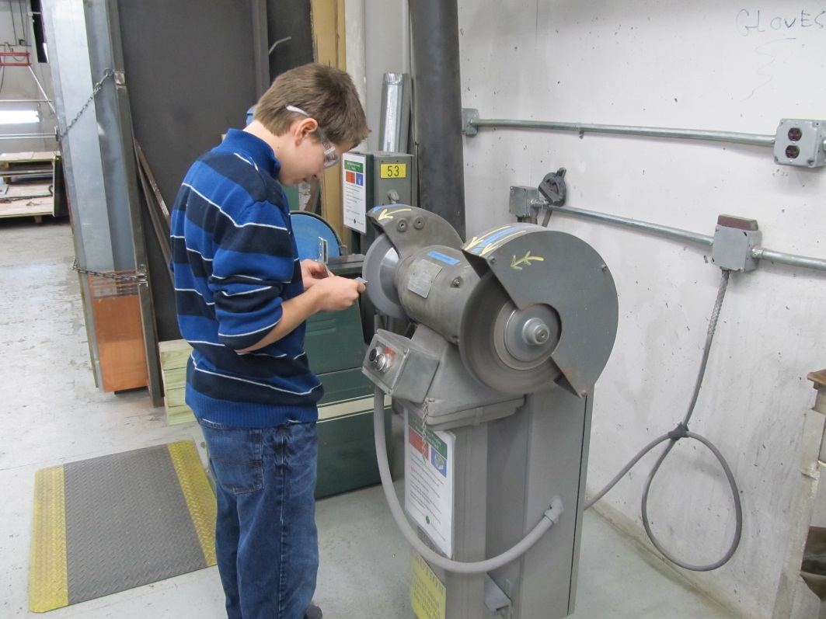
Cut angle
Use metal angle pieces on the frame side to reinforce your joints, using screws running perpendicular to the angle to secure them.

Slide 6
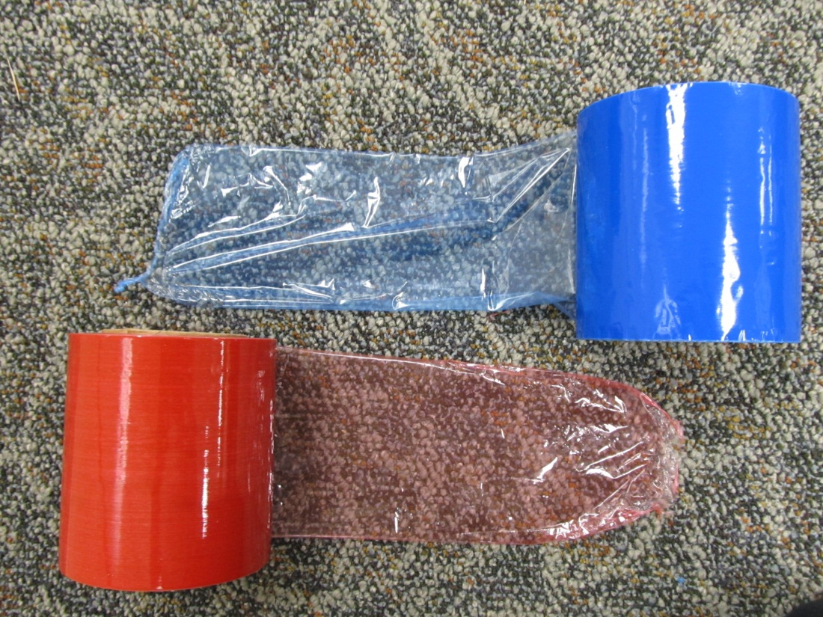
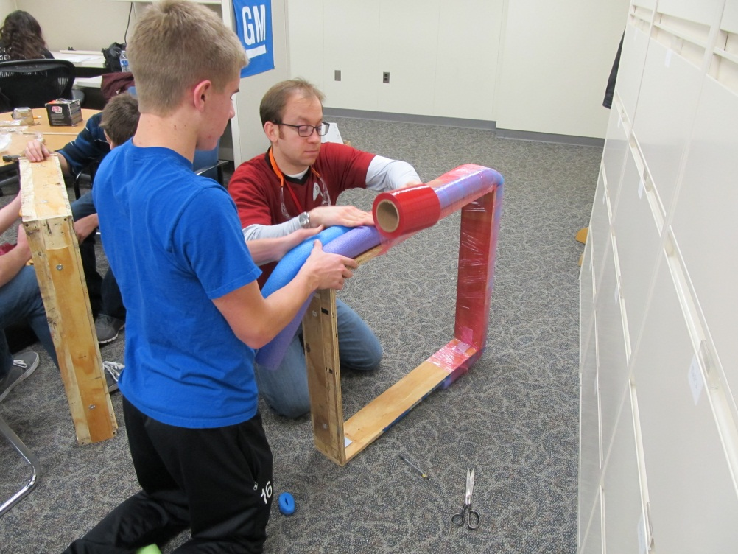
Finishing
Encircle bumpers in pool noodle, wrap with plastic wrap, and seal plastic wrap with a quick once over with a heat gun.

Slide 7
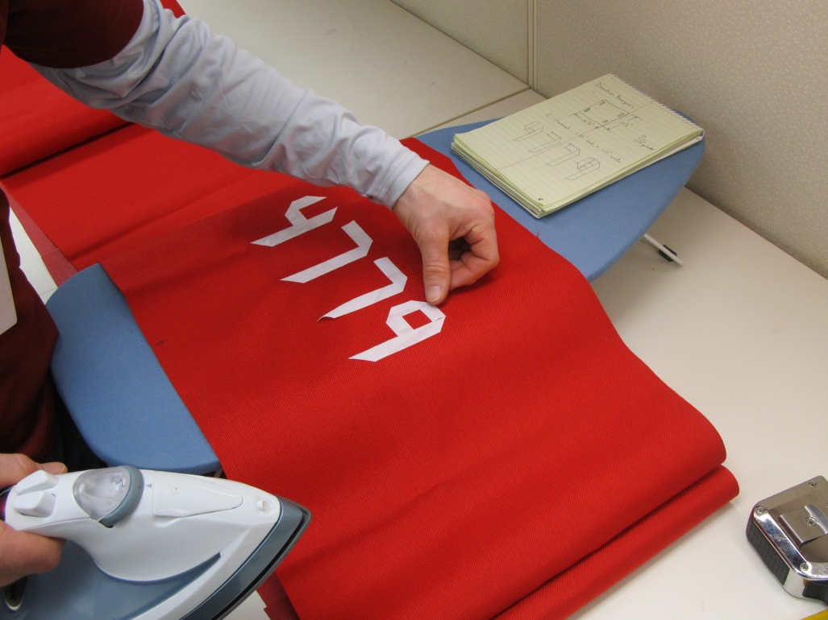
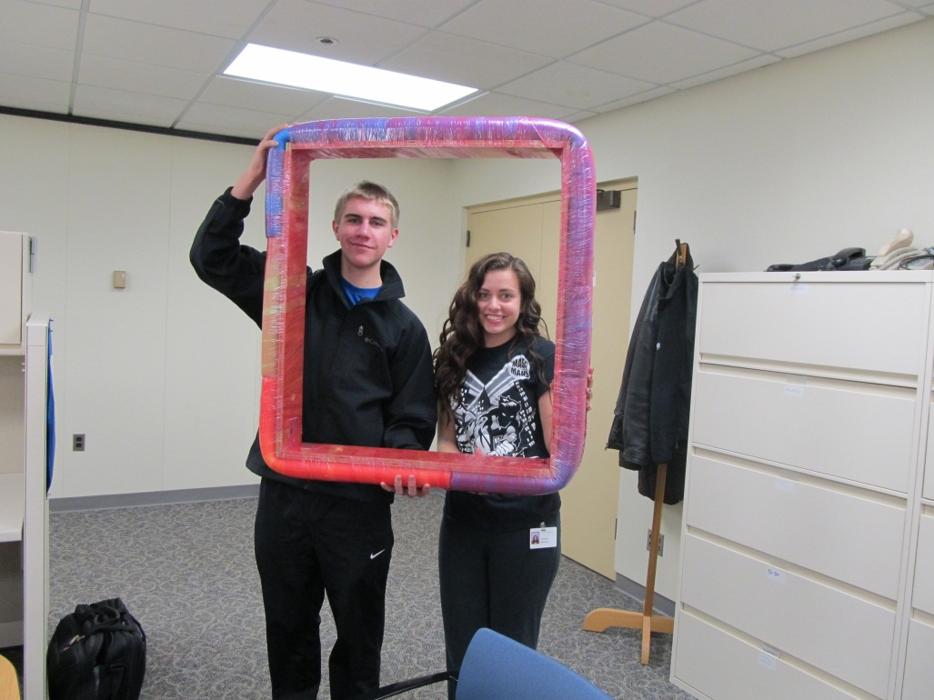
Team #’s and The Cloth Wrap
Cut cloth to wrap around the bumpers. Cut numbers for your team and glue or iron them in place. Staple cloth in place.

